Slide 1
Introduction to Zigbee Smart Energy
A Global Standard for Efficient Energy Management
Pritom Bhowmik(2101005)
MD Rohan Mondal(2101041)
MD Naimur Rashid(2101042)

Slide 2
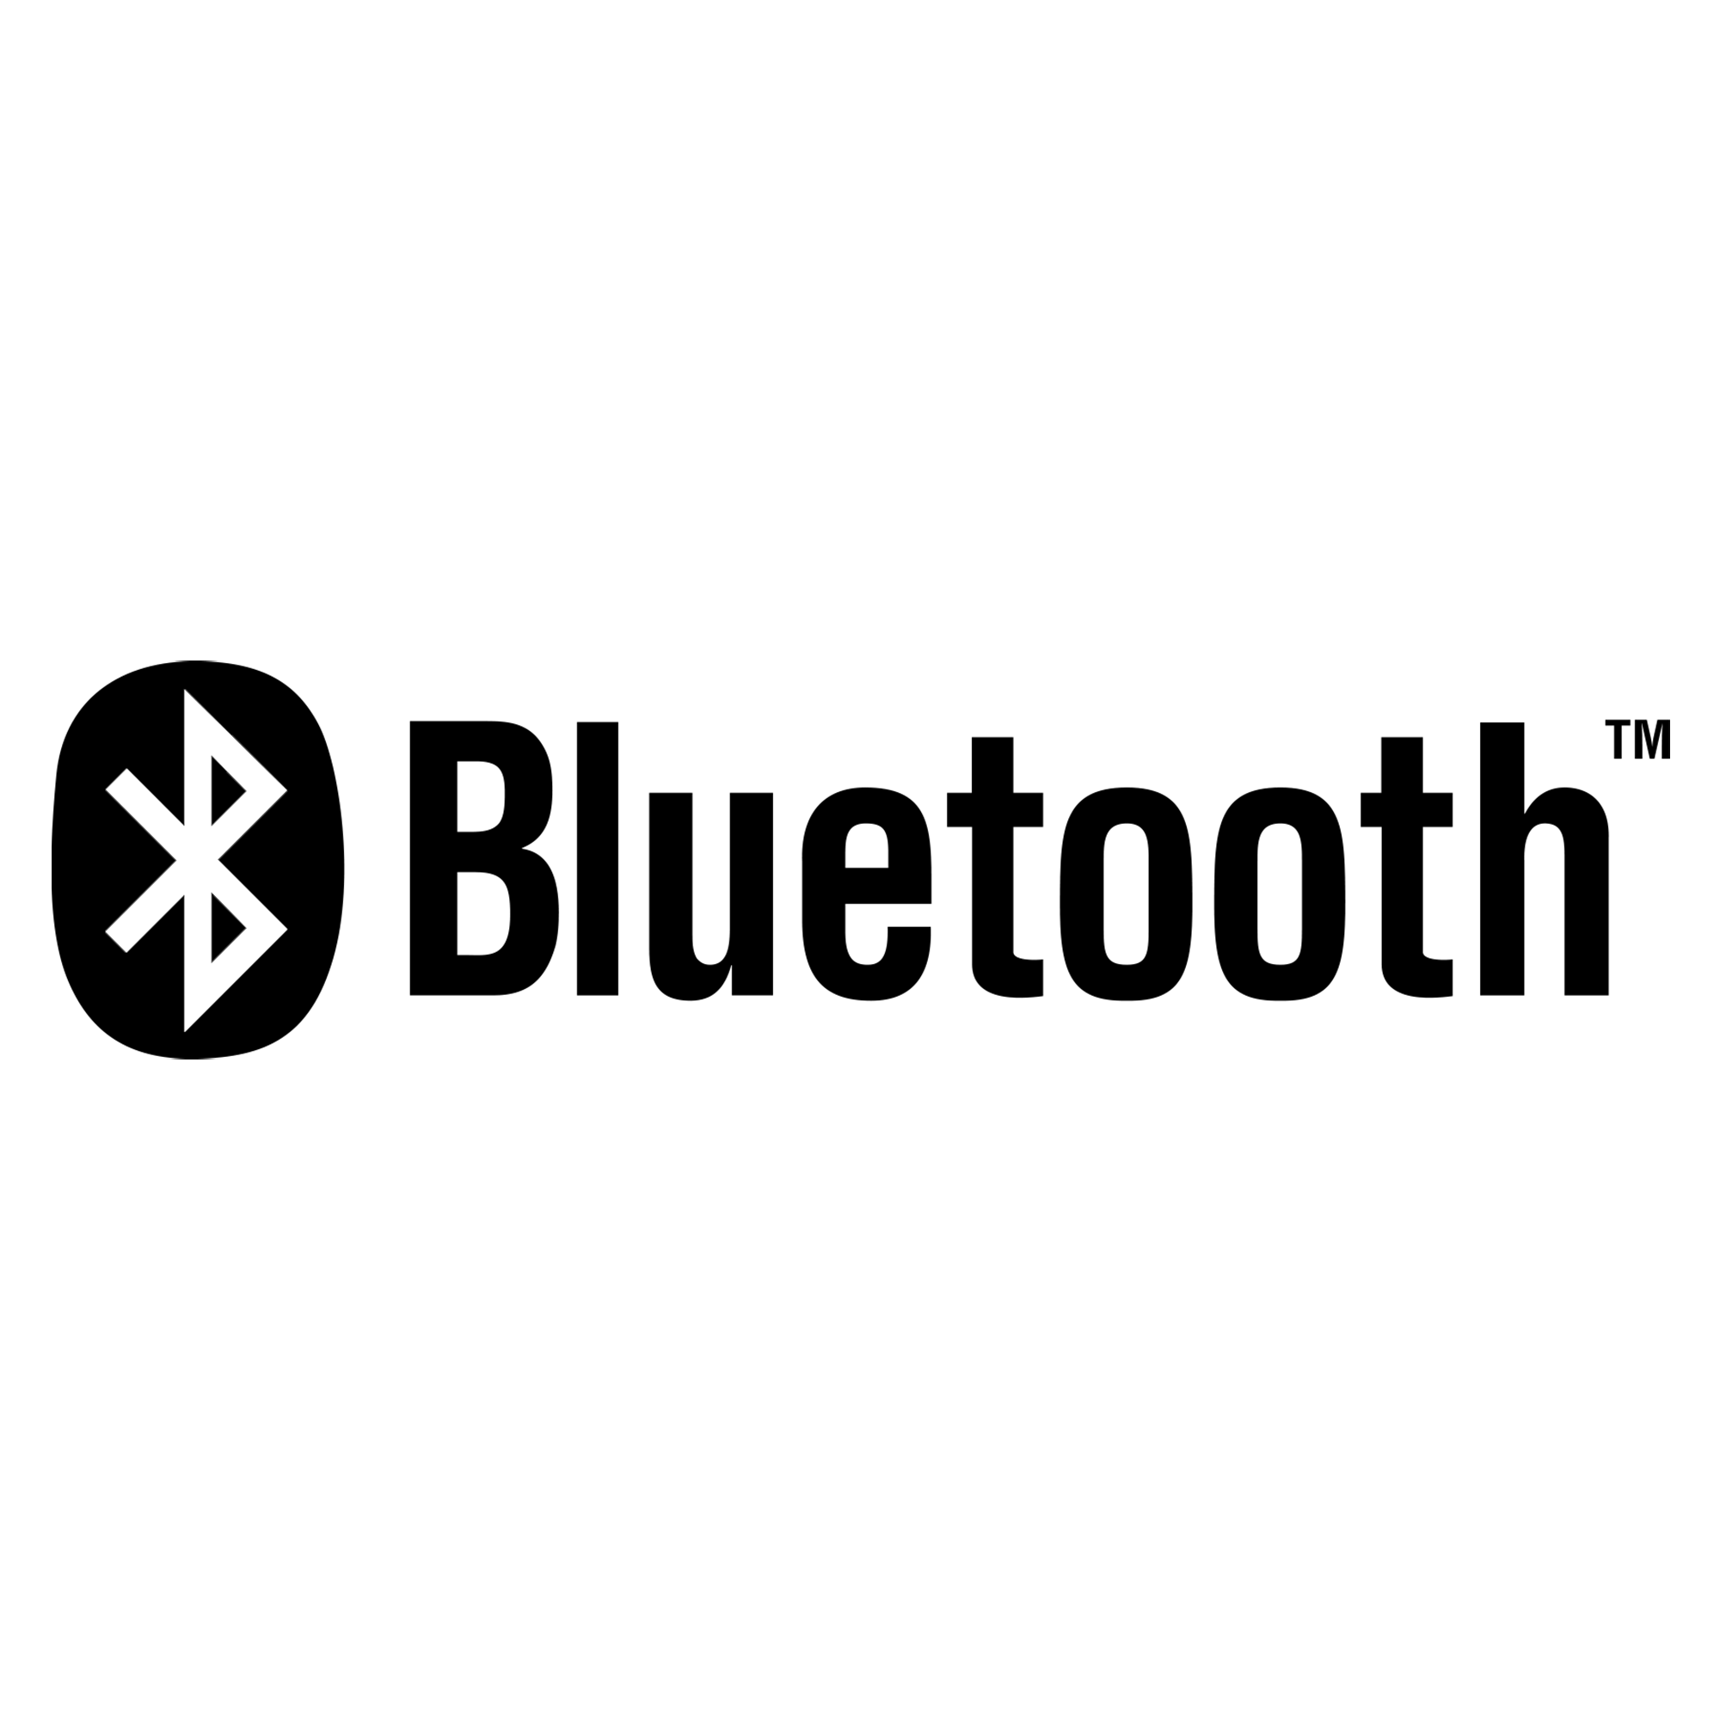

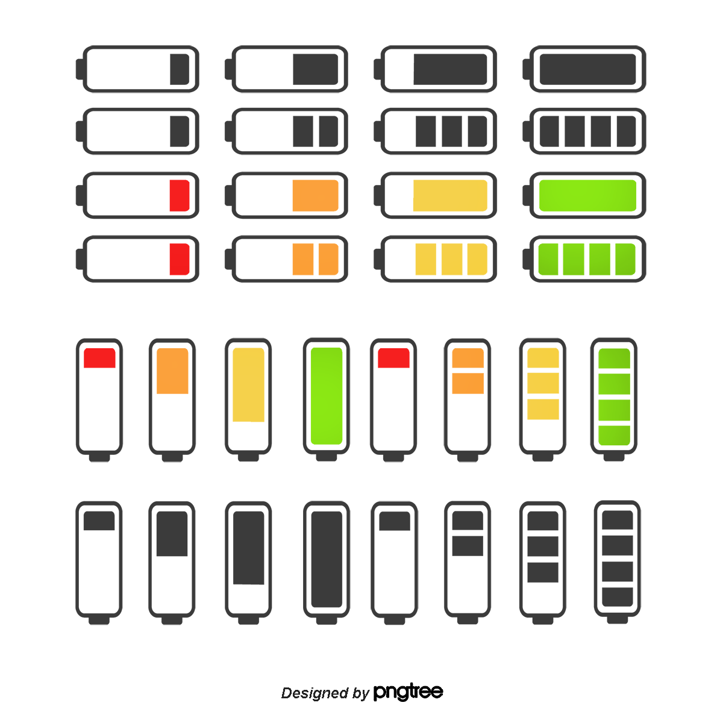

What is ZigBee?
What if we connect a large number of battery operated devices?
We are usually use Bluetooth and Wifi to connect devices.
Streaming Audio
Streaming Video or larger file

Slide 3

What is ZigBee?
We are usually use Bluetooth and Wifi to connect devices.
What if we connect a large number of battery operated devices?
Streaming Video or larger file
Streaming Audio
Is it ok to use Wifi or Bluetooth?

Slide 4
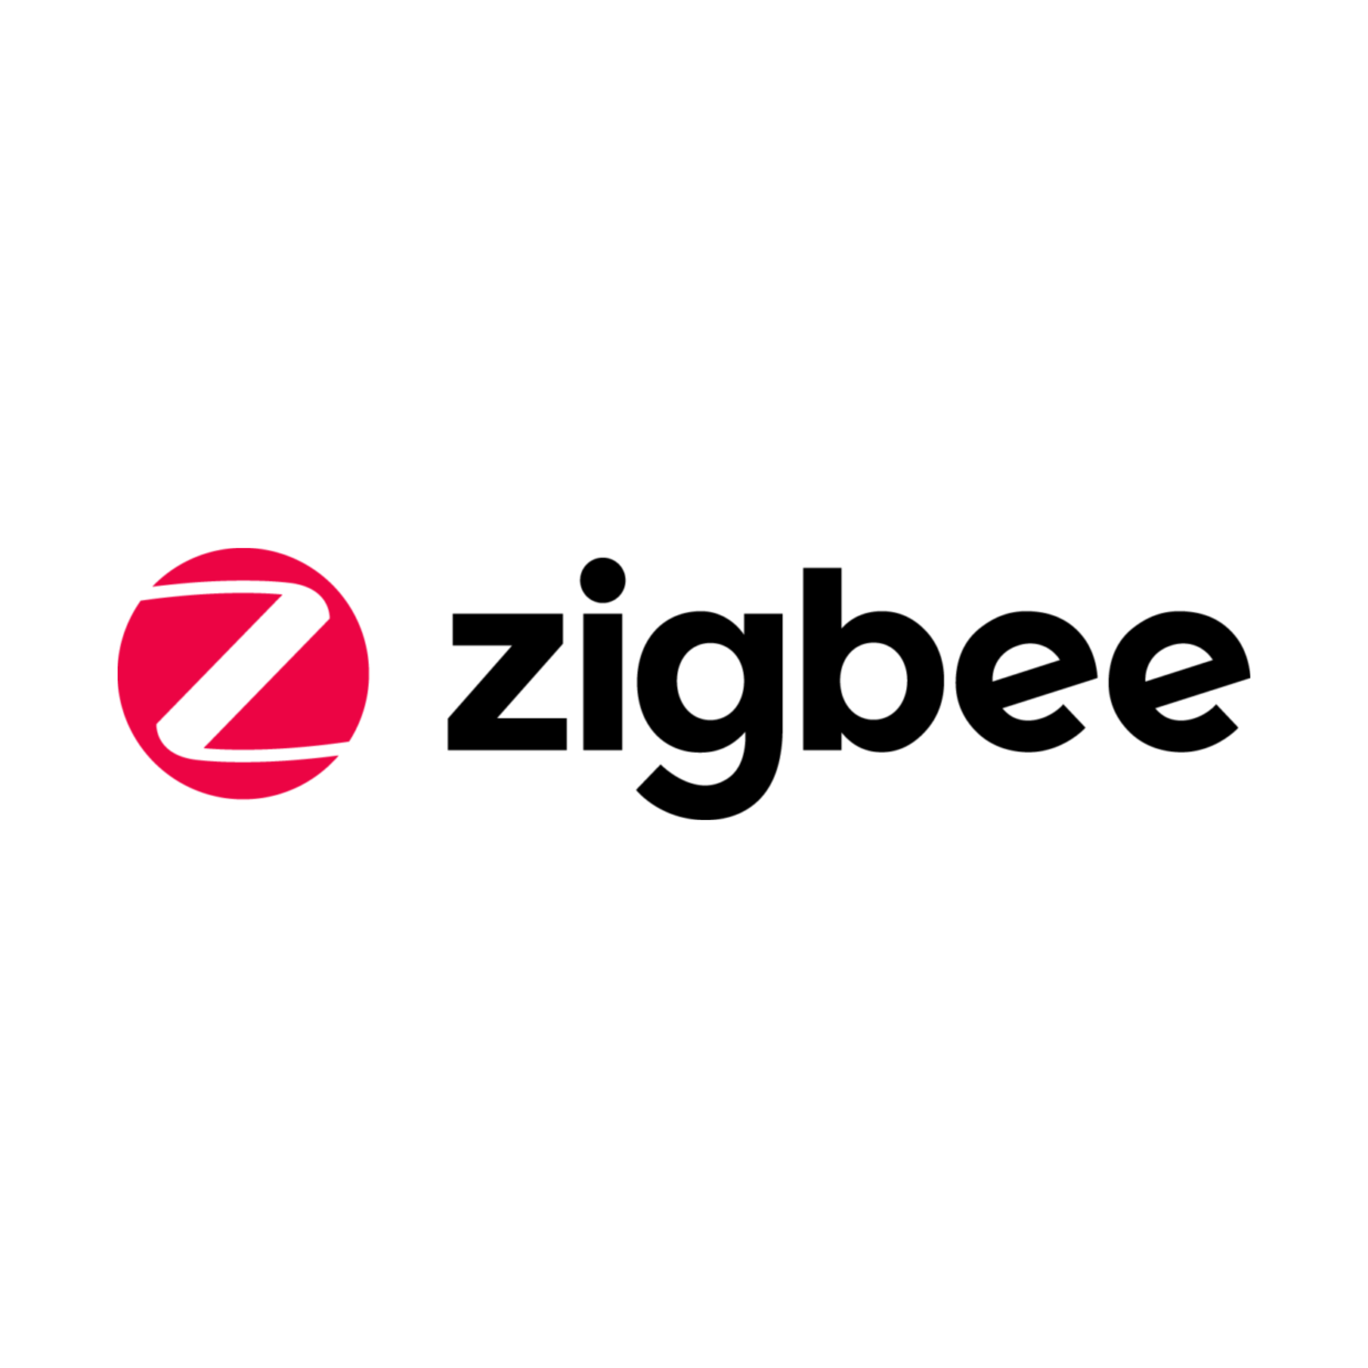
What is ZigBee?
What if we connect a large number of battery operated devices?
Here comes Zigbee to connect a large number of battery operated devices
Is it ok to use Wifi or Bluetooth?
Only a Limited number of devices can be connected
Consumes many Power

Slide 5
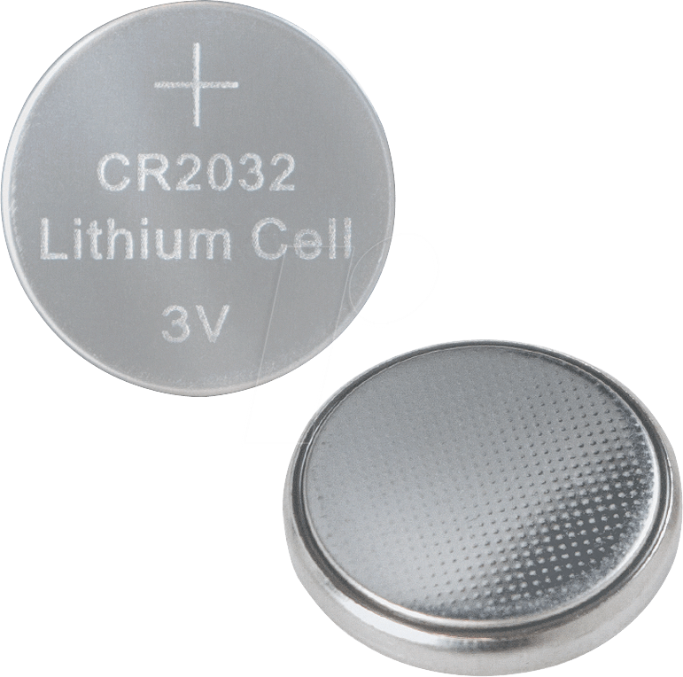
What is ZigBee?
Here comes Zigbee to connect a large number of battery operated devices
Is it ok to use Wifi or Bluetooth?
Consumes many Power
Only a Limited number of devices can be connected
Zigbee, like Wifi and Bluetooth is a short range wireless protocol.
.
It is designed to meet the needs of low-cost battery operated applications where longer battery life is of the major concern
Zigbee is build on IEEE 802.15.4 Physical layer.

Slide 6
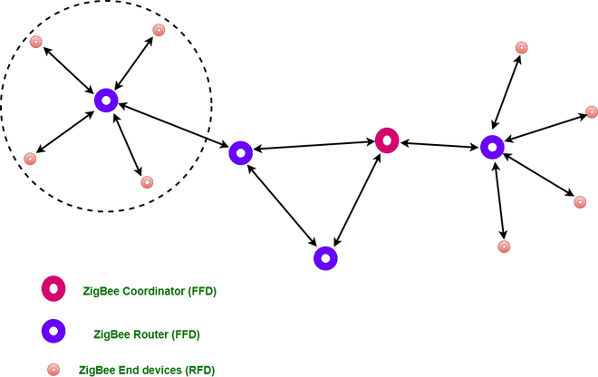
What is ZigBee?
Here comes Zigbee to connect a large number of battery operated devices
Zigbee, like Wifi and Bluetooth is a short range wireless protocol.
Zigbee Coordinator Device: It communicates with routers. This device is used for connecting the devices.
Zigbee is build on IEEE 802.15.4 Physical layer.
Zigbee Router: It is used for passing the data between devices.
.
It is designed to meet the needs of low-cost battery operated applications where longer battery life is of the major concern
Zigbee End Device: It is the device that is going to be controlled.

Slide 7
What is ZigBee?
Here comes Zigbee to connect a large number of battery operated devices
Model
Zigbee Coordinator Device: It communicates with routers. This device is used for connecting the devices.
Zigbee Router: It is used for passing the data between devices.
Zigbee uses a mesh network topology, which allows for devices to communicate with each other without the need for a central hub or router.
Zigbee End Device: It is the device that is going to be controlled.
.
It is designed to meet the needs of low-cost battery operated applications where longer battery life is of the major concern
Zigbee, like Wifi and Bluetooth is a short range wireless protocol.
Zigbee is build on IEEE 802.15.4 Physical layer.

Slide 8
What is ZigBee?
Here comes Zigbee to connect a large number of battery operated devices
Model
Zigbee Coordinator Device: It communicates with routers. This device is used for connecting the devices.
Zigbee End Device: It is the device that is going to be controlled.
Zigbee Router: It is used for passing the data between devices.

Slide 9
What is ZigBee?
Here comes Zigbee to connect a large number of battery operated devices
Model
Zigbee Router: It is used for passing the data between devices.
Zigbee Coordinator Device: It communicates with routers. This device is used for connecting the devices.
Zigbee End Device: It is the device that is going to be controlled.

Slide 10
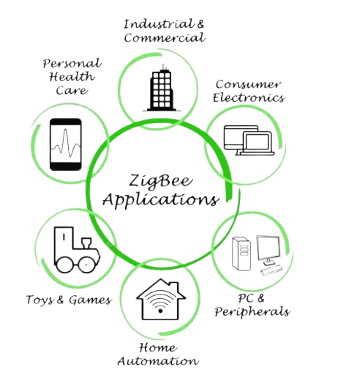
What is ZigBee?
Zigbee Router: It is used for passing the data between devices.
Model
Zigbee Coordinator Device: It communicates with routers. This device is used for connecting the devices.
Zigbee Applications:
Home Automation
Medical Data Collection
Industrial Control Systems
meter reading system
light control system
Commercial
Government Markets Worldwide
Home Networking devices.
Zigbee End Device: It is the device that is going to be controlled.

Slide 11
Zigbee Coordinator Device: It communicates with routers. This device is used for connecting the devices.
Model
Zigbee Applications:
Home Automation
Medical Data Collection
Industrial Control Systems
meter reading system
light control system
Commercial
Government Markets Worldwide
Home Networking devices.

Slide 12
Zigbee Smart Energy (ZSE)

Slide 13
What is ZigBee Smart Energy?
Zigbee Smart Energy (Zigbee SE) is a protocol designed for monitoring and actively managing energy consumption at the end-user level. For both utilities and consumers, Zigbee SE can help reduce waste, energy consumption and enables utilities to monitor and manage customers’ energy use.
ZigBee Smart Energy enables wireless communication and automation between utility companies, the Smart Grid and common household devices such as thermostats, water heaters, pool pumps and appliances. It improves energy efficiency by allowing consumers to manage their energy consumption more precisely using automation and near real-time information.

Slide 14

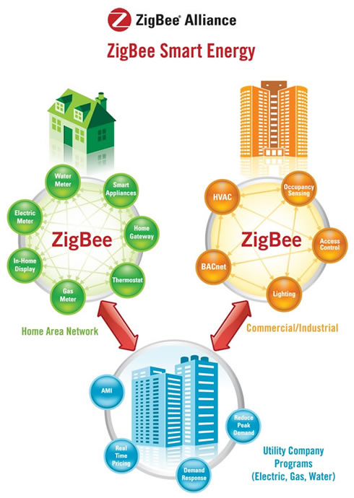

ZigBee Smart Energy ecosystem

Slide 15
ZigBee Smart Energy ecosystem
Home Area Network (HAN):
ZigBee enables communication between home devices like:
Electric meters
Gas meters
Water meters
Smart appliances
Thermostats
In-home displays
Home gateways
These devices work together to optimize energy usage, provide real-time consumption data, and allow for automation in residential environments.

Slide 16
ZigBee Smart Energy ecosystem
Commercial/Industrial Applications:
ZigBee integrates with systems like:
HVAC (Heating, Ventilation, and Air Conditioning)
Lighting systems
Occupancy sensors
Access control systems
Helps improve energy efficiency and automation in industrial and commercial spaces by linking various devices.

Slide 17
ZigBee Smart Energy ecosystem
Utility Company Programs:
Utility companies use ZigBee for programs involving:
Advanced Metering Infrastructure (AMI)
Real-time energy pricing
Demand response systems
Peak demand reduction strategies
These programs enhance energy distribution efficiency and meet regulatory demands while giving consumers more control.

Slide 18


Why is ZigBee Smart Energy ideal for energy management?
ZigBee Smart Energy helps utility companies implement new advanced metering and demand response programs to drive greater energy management and efficiency, while responding to regulatory requirements for the use of open standards. ZigBee Smart Energy offers innovative electric, gas and water utilities support for advanced metering, demand response, load control, pricing, and customer messaging programs. It provides communication and control for devices such as in-home displays, programmable communicating thermostats, water heaters, lighting, smart appliances, plug-in hybrid electric vehicles, plus energy service portals and energy management systems.
Many consumers are well aware of their electricity bills rising but may not realize that the cost of electricity can fluctuate widely and rapidly throughout a single day. Communicating price, and price fluctuations, can allow consumers to see huge savings by automatically reducing energy consumption.

Slide 19
Why is ZigBee Smart Energy ideal for home energy management?
Many consumers are well aware of their electricity bills rising but may not realize that the cost of electricity can fluctuate widely and rapidly throughout a single day. Communicating price, and price fluctuations, can allow consumers to see huge savings by automatically reducing energy consumption.
ZigBee Smart Energy helps utility companies implement new advanced metering and demand response programs to drive greater energy management and efficiency, while responding to regulatory requirements for the use of open standards. ZigBee Smart Energy offers innovative electric, gas and water utilities support for advanced metering, demand response, load control, pricing, and customer messaging programs. It provides communication and control for devices such as in-home displays, programmable communicating thermostats, water heaters, lighting, smart appliances, plug-in hybrid electric vehicles, plus energy service portals and energy management systems.

Slide 20
Zigbee Protocol & Types of Zigbee Networks

Slide 21
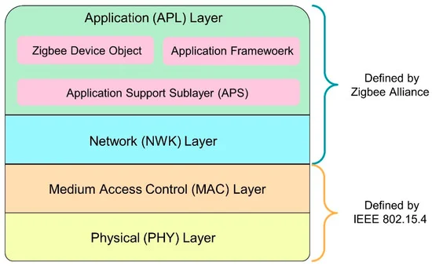
Zigbee Protocol
Zigbee protocol stack, structured into layers defined by either the IEEE 802.15.4 standard or the Zigbee Alliance:
Physical (PHY) Layer: Handles physical transmission of data. Defined by IEEE 802.15.4.
MAC Layer: Manages access to the medium, collision avoidance, and data framing. Defined by IEEE 802.15.4.
Network (NWK) Layer: Manages routing, addressing, and network formation. Defined by the Zigbee Alliance.
Application (APL) Layer:
Application Framework: Supports user-defined applications.
Zigbee Device Object (ZDO): Manages device roles and communication setup.
Application Support Sublayer (APS): Provides data delivery services.

Slide 22
Zigbee Types
Types | Examples | Applications
Topology | Star, Mesh, Tree | Home automation, smart grids
Device Role | Coordinator, Router, End Device | Network management, data relaying
Application Profiles | Smart Energy, Home Automation | Energy monitoring, lighting control
Standards | Zigbee 2004/2006/2007, Zigbee Pro, Zigbee 3.0 | Advanced IoT and automation systems

Slide 23
Zigbee Types Based on Zigbee Standards
1. Zigbee 2004/2006/2007
Early versions designed for basic wireless communication with limited interoperability.
2. Zigbee Pro (2007 and later)
Advanced features like mesh networking, improved security, and support for larger networks.
Zigbee Pro is the foundation of modern Zigbee implementations.
3. Zigbee 3.0
A unified standard combining all previous application profiles.
Enhances interoperability, security, and energy efficiency.

Slide 24
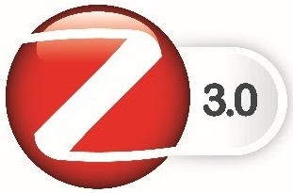
Zigbee 3.0 and Its Specifications

Slide 25
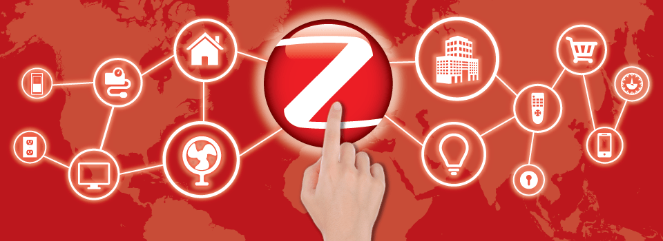
Zigbee 3.0
Zigbee 3.0 is the latest unified protocol from the Zigbee Alliance (now the Connectivity Standards Alliance), designed to integrate and standardize all Zigbee application profiles into a single, versatile framework. This update improves interoperability, functionality, and security, making it a powerful choice for IoT and smart applications.
Many consumers are well aware of their electricity bills rising but may not realize that the cost of electricity can fluctuate widely and rapidly throughout a single day. Communicating price, and price fluctuations, can allow consumers to see huge savings by automatically reducing energy consumption.

Slide 26

Key Features of Zigbee Smart Energy

Slide 27

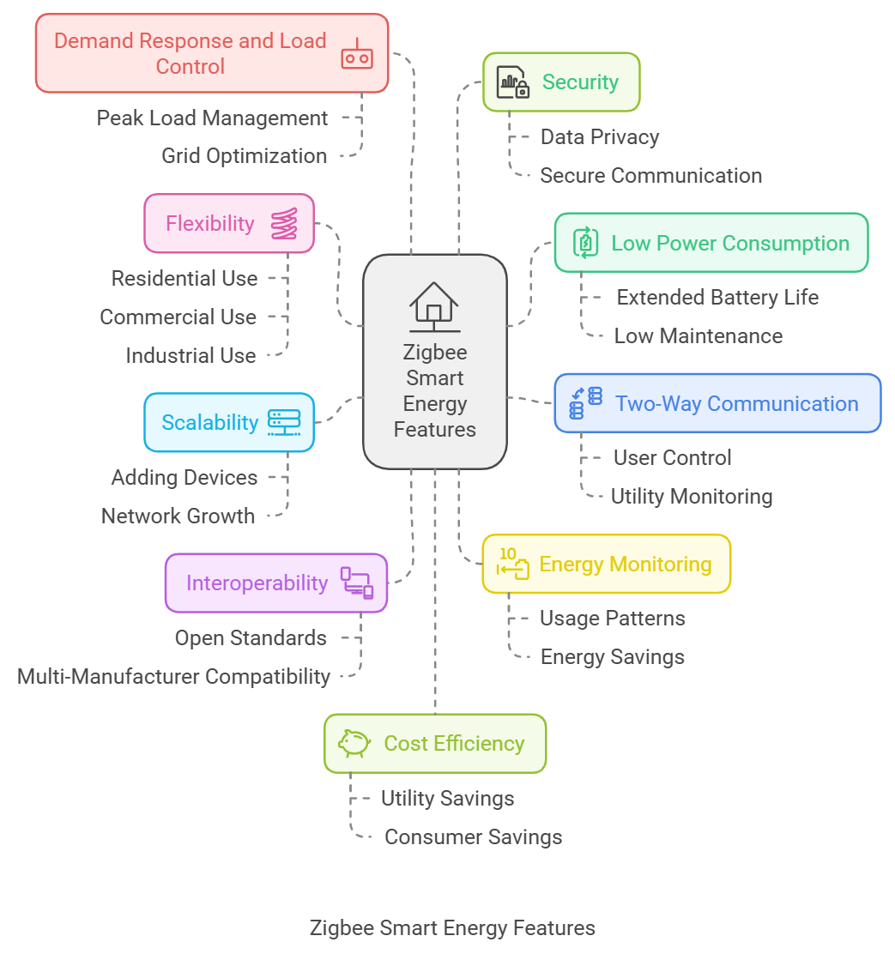

Slide 28
ZigBee 3.0 and Specifications

Slide 29
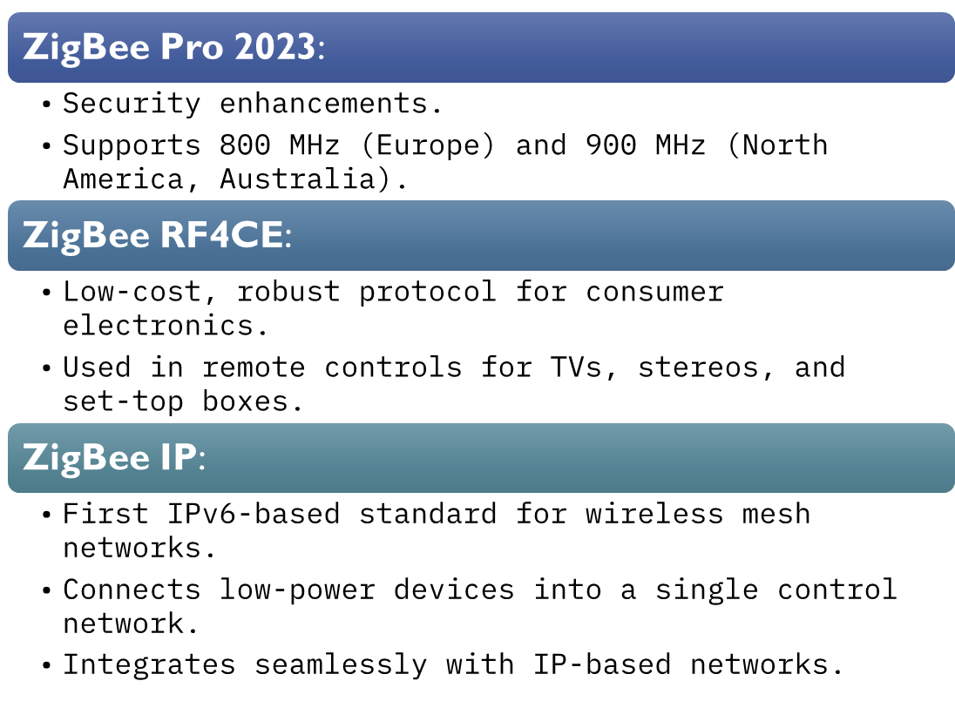
Zigbee 3.0 and Specifications
Many consumers are well aware of their electricity bills rising but may not realize that the cost of electricity can fluctuate widely and rapidly throughout a single day. Communicating price, and price fluctuations, can allow consumers to see huge savings by automatically reducing energy consumption.

Slide 30
Zigbee 3.0 and Specifications
Feature | Details
Standard | IEEE 802.15.4
Frequency Bands | 2.4 GHz, 868 MHz, 915 MHz
Data Rate | Up to 250 kbps
Range | 10–100 meters (indoor/outdoor)
Security | AES-128 encryption
Nodes per Network | Up to 65,000
Interoperability | Cross-device and manufacturer support
Many consumers are well aware of their electricity bills rising but may not realize that the cost of electricity can fluctuate widely and rapidly throughout a single day. Communicating price, and price fluctuations, can allow consumers to see huge savings by automatically reducing energy consumption.

Slide 31
Components of Zigbee Smart Energy Systems

Slide 32
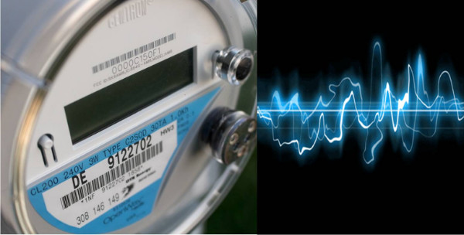
Smart Meters and Their Role in Energy Measurement
Smart meters are the backbone of Zigbee Smart Energy systems, designed to measure, monitor, and transmit energy usage data.
Many consumers are well aware of their electricity bills rising but may not realize that the cost of electricity can fluctuate widely and rapidly throughout a single day. Communicating price, and price fluctuations, can allow consumers to see huge savings by automatically reducing energy consumption.

Slide 33
Smart Meters and Their Role in Energy Measurement
Many consumers are well aware of their electricity bills rising but may not realize that the cost of electricity can fluctuate widely and rapidly throughout a single day. Communicating price, and price fluctuations, can allow consumers to see huge savings by automatically reducing energy consumption.
Role and Functions:
Real-Time Monitoring: Provide live data on electricity, gas, or water consumption.
Accurate Billing: Eliminate the need for manual readings, ensuring precise billing.
Two-Way Communication: Transmit usage data to utility providers while receiving updates or commands, such as tariff changes or demand response signals.
Load Management: Help utilities monitor peak loads and optimize grid performance.
Energy Optimization: Enable consumers to track their usage and adjust behaviors to reduce costs and energy waste.

Slide 34
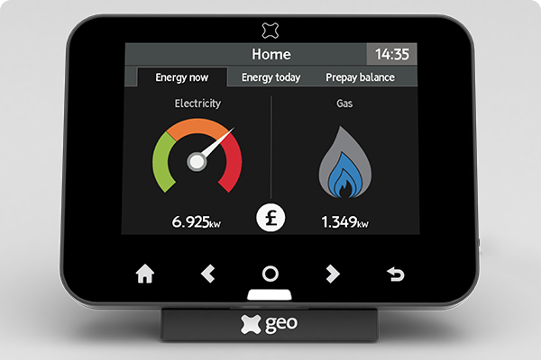
In-Home Displays (IHDs) for User Interaction
In-home displays (IHDs) are user-friendly devices that provide a visual interface for consumers to interact with their energy usage data.
Many consumers are well aware of their electricity bills rising but may not realize that the cost of electricity can fluctuate widely and rapidly throughout a single day. Communicating price, and price fluctuations, can allow consumers to see huge savings by automatically reducing energy consumption.

Slide 35
In-Home Displays (IHDs) for User Interaction
Many consumers are well aware of their electricity bills rising but may not realize that the cost of electricity can fluctuate widely and rapidly throughout a single day. Communicating price, and price fluctuations, can allow consumers to see huge savings by automatically reducing energy consumption.
Role and Functions:
Energy Insights: Display real-time consumption data, historical usage, and cost projections.
Alerts and Notifications: Inform users about high energy usage, pricing changes, or system updates.
Behavioral Impact: Encourage energy-saving habits by showing clear, actionable data.
Control Interface: Some IHDs allow users to adjust settings for connected devices, such as thermostats or appliances.

Slide 36
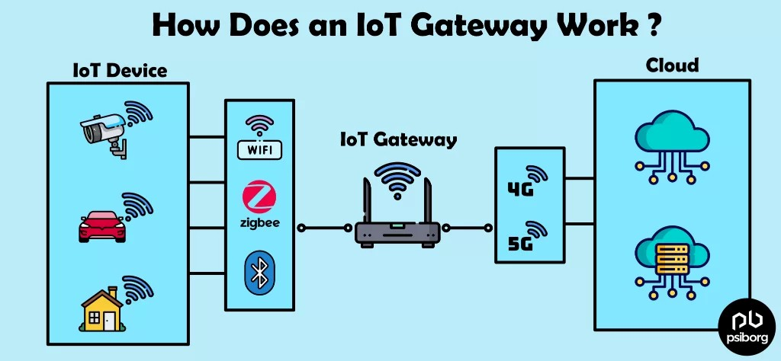
Gateways and Their Role in Connecting Devices to the Cloud
Gateways act as the central hub in Zigbee Smart Energy systems, linking local devices to external networks and cloud-based services.
Many consumers are well aware of their electricity bills rising but may not realize that the cost of electricity can fluctuate widely and rapidly throughout a single day. Communicating price, and price fluctuations, can allow consumers to see huge savings by automatically reducing energy consumption.

Slide 37
Gateways and Their Role in Connecting Devices to the Cloud
Many consumers are well aware of their electricity bills rising but may not realize that the cost of electricity can fluctuate widely and rapidly throughout a single day. Communicating price, and price fluctuations, can allow consumers to see huge savings by automatically reducing energy consumption.
Role and Functions:
Data Aggregation: Collect data from Zigbee-enabled devices like smart meters and sensors.
Cloud Connectivity: Transmit aggregated data to cloud platforms for analysis, storage, and remote access.
Device Coordination: Enable communication between different devices within the Zigbee Network.
Remote Control: Allow utility providers and users to manage devices remotely via apps or web interfaces.

Slide 38
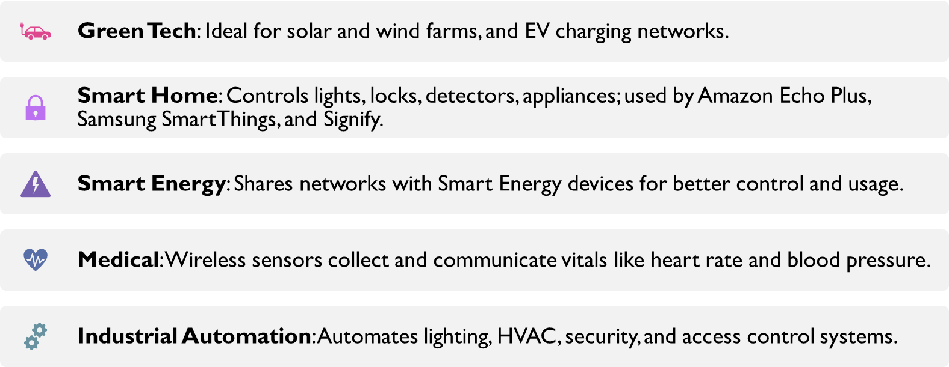
Common Wireless Applications for ZigBee 3.0

Slide 39
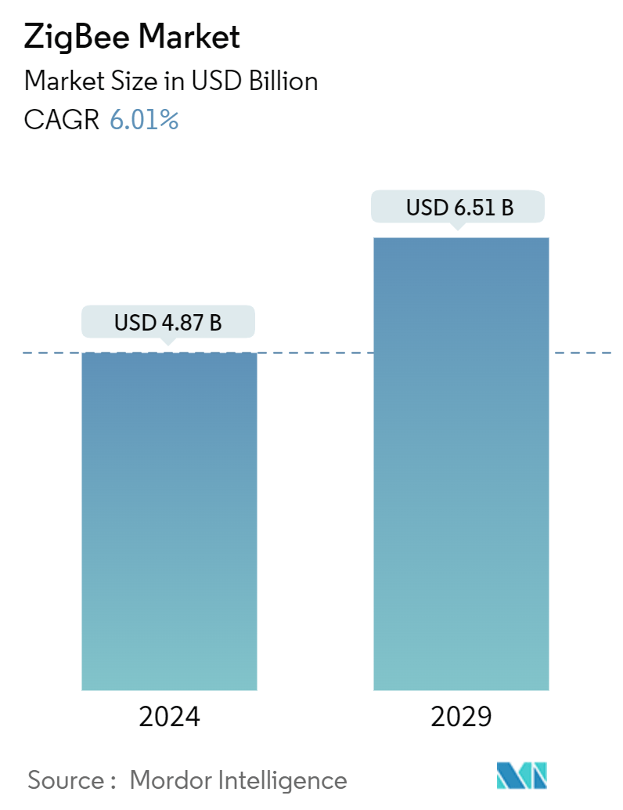
Advantages of Zigbee Smart Energy
Low Power Consumption:
Zigbee devices are energy-efficient, lasting for several years on a single battery charge, making them ideal for smart meters and sensors.
Cost-Effectiveness:
Lower implementation costs compared to alternatives like Wi-Fi or cellular-based solutions. Suitable for large-scale deployment across homes, industries, and municipalities.
Scalability and Flexibility:
Supports thousands of devices in a single network, allowing easy expansion of smart energy networks.
Mesh Networking and Reliability:
Mesh architecture enhances communication reliability, allowing data to be routed through multiple devices and reducing failure risks.
Data Transmission and Latency:
Supports low-latency applications, ensuring real-time monitoring and control in energy management systems.

Slide 40
Zigbee vs Other Wireless Technologies
Zigbee vs Wi-Fi:
Wi-Fi offers higher throughput but consumes significantly more power. Zigbee is ideal for low-bandwidth, battery-powered devices, while Wi-Fi is better for high-bandwidth applications.
Zigbee vs Bluetooth:
Bluetooth is suited for short-range, fast connections like audio streaming, whereas Zigbee excels in smart home and industrial automation scenarios with longer-range, energy-efficient communication.
Zigbee vs LoRaWAN:
LoRaWAN is designed for long-range, low-power wide-area networks, making it better for rural or city-wide IoT applications. Zigbee is more appropriate for localized, home or industrial networks.

Slide 41
Zigbee vs Other Wireless Technologies
Feature | Zigbee | Wi-Fi | Bluetooth | LoRaWAN | Z-Wave
Power | Low | High | Moderate | Very Low | Low
Range | 10-100m | ~50m indoors | 10m | 10+ km | ~30-50m
Data Rate | ~250 Kbps | 11-54 Mbps | 1-3 Mbps | 0.3-50 Kbps | 100 Kbps
Topology | Mesh | Point-to-Point | Point-to-Point | Star | Mesh
Cost | Low | High | Low | Low | Moderate

Slide 42
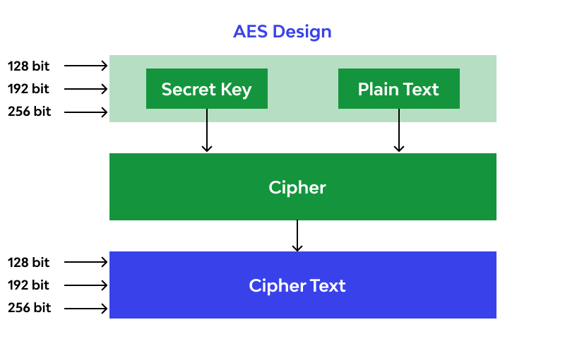
Security and Privacy in Zigbee Smart Energy
Security Protocols:
Zigbee employs 128-bit AES encryption to secure data at various layers, ensuring confidentiality and integrity in communication.
Authentication and Access Control: Zigbee uses device-specific keys to authenticate devices joining the network, preventing unauthorized access.
Data Integrity: Protects transmitted data from tampering or malicious interference.

Slide 43
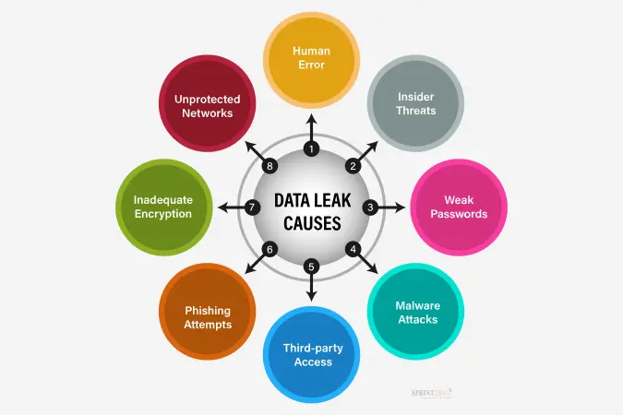
Security and Privacy in Zigbee Smart Energy
Privacy Concerns:
Data Leakage: Misconfigured networks may leak sensitive energy usage data.
Physical Attacks: Devices installed in public or semi-public areas are vulnerable to tampering or unauthorized access.
Mitigation Strategies:
Regular Software Updates: Ensures devices have the latest security patches.
Network Monitoring: Implement monitoring tools to detect and mitigate unauthorized access or anomalies in the network.
Enhanced Encryption: Deploy more advanced encryption methods or multi-factor authentication (MFA) for sensitive applications.

Slide 44
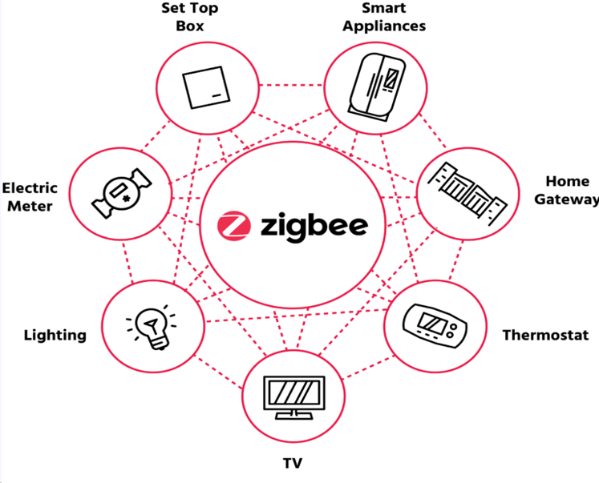
Real-World Applications and Use Cases
Smart Metering:
Zigbee enables automatic meter reading, allowing utility companies to collect energy consumption data remotely and in real time. This reduces operational costs and improves billing accuracy.
Home Energy Management Systems (HEMS):
Consumers can manage and monitor their energy consumption with Zigbee-enabled devices such as smart thermostats, lighting controls, and energy-efficient appliances.
Integration with renewable energy sources like solar panels allows for better load balancing and reduced energy costs.
Smart Grid Integration:
Zigbee is integral to demand-response systems, where energy consumption is adjusted dynamically based on grid conditions. It enhances efficiency by allowing utilities to shift demand and reduce peak loads.
Industrial Automation:
Industries use Zigbee for energy monitoring systems to optimize energy consumption, reduce wastage, and implement predictive maintenance in machinery and production lines.

Slide 45
Challenges and Future Trends
Challenges:
Interference with Other Devices: Zigbee operates in the crowded 2.4 GHz spectrum, which can lead to interference from Wi-Fi, Bluetooth, and other technologies.
Limited Bandwidth: Zigbee’s low data rate may not be suitable for applications that require higher throughput.
Security Concerns: Although Zigbee has robust security features, large-scale deployment in critical infrastructure (e.g., smart grids) makes it a target for cyber-attacks.
Future Trends:
5G and IoT Integration: Future versions of Zigbee may leverage 5G technology to enhance connectivity, speed, and reliability, especially in smart cities.
Interoperability with IoT Standards: With the rise of Matter (formerly Project CHIP) and other IoT standards, Zigbee devices may become more interoperable with different ecosystems.
Enhanced Security Protocols: Improved encryption algorithms and blockchain-based security models may be adopted to address increasing concerns over data privacy and cyber threats.

Slide 46



Any Question??
Conclusion:
Key Takeaways:
Zigbee Smart Energy offers a cost-effective, scalable, and energy-efficient solution for a wide range of smart energy applications.
Security and privacy are crucial considerations, requiring constant attention and regular updates to prevent vulnerabilities.
Despite challenges like interference and bandwidth limitations, Zigbee remains a valuable player in smart energy systems, especially for home automation and industrial use.
Looking Forward:
The future of Zigbee will likely see integration with newer technologies like 5G and the IoT, addressing existing challenges and expanding its use in smart grids and energy management.

Slide 47
Arigato gozaimasu
Conclusion:
(Thank you)
Key Takeaways:
Zigbee Smart Energy offers a cost-effective, scalable, and energy-efficient solution for a wide range of smart energy applications.
Security and privacy are crucial considerations, requiring constant attention and regular updates to prevent vulnerabilities.
Despite challenges like interference and bandwidth limitations, Zigbee remains a valuable player in smart energy systems, especially for home automation and industrial use.
Looking Forward:
The future of Zigbee will likely see integration with newer technologies like 5G and the IoT, addressing existing challenges and expanding its use in smart grids and energy management.
Any Question??

Slide 48

Any Question??
Arigato gozaimasu
(Thank you)

Slide 49
Questions
What information does ZigBee Smart Energy-enabled devices provide to help consumers make smarter energy choices? What kind of devices is ZigBee Smart Energy being integrated into?
As a homeowner, how do I go about getting a ZigBee Smart Energy system installed in my home? What are the opportunities for consultants and system integrators and how do they go about getting up to speed on these opportunities?

